Slide 1

Evolutionary Methods in Multi-Objective Optimization
- Why do they work ? -
Lothar Thiele
Computer Engineering and Networks Laboratory
Dept. of Information Technology and Electrical Engineering
Swiss Federal Institute of Technology (ETH) Zurich
Computer Engineering
and Networks Laboratory

Slide 2
Overview
❶ introduction
❷ limit behavior
❸ run-time
❹ performance measures

Slide 3
Black-Box Optimization
objective function
?
decision vector x
objective vector f(x)
(e.g. simulation model)
Optimization Algorithm:
only allowed to evaluate f (direct search)
Notes:
This has serious restrictions for an optimization algorithm.
The optimization algorithm can only gain information about the objective function by actually evaluating it.

Slide 4

Issues in EMO
How to maintain a diverse
Pareto set approximation?
❷ density estimation
How to prevent nondominated
solutions from being lost?
❸ environmental selection
How to guide the population
towards the Pareto set?
❶ fitness assignment
y2
Diversity
y1
Convergence

Slide 5
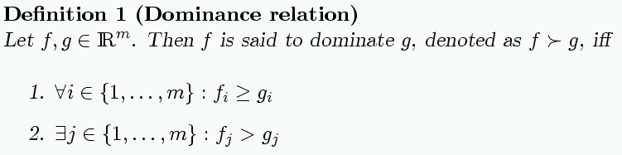
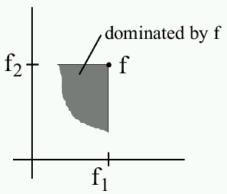
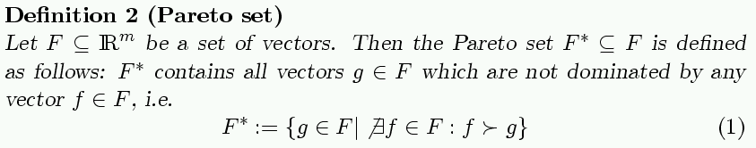
Multi-objective Optimization

Slide 6
A Generic Multiobjective EA
population
archive
evaluate
sample
vary
update
truncate
new population
new archive

Slide 7
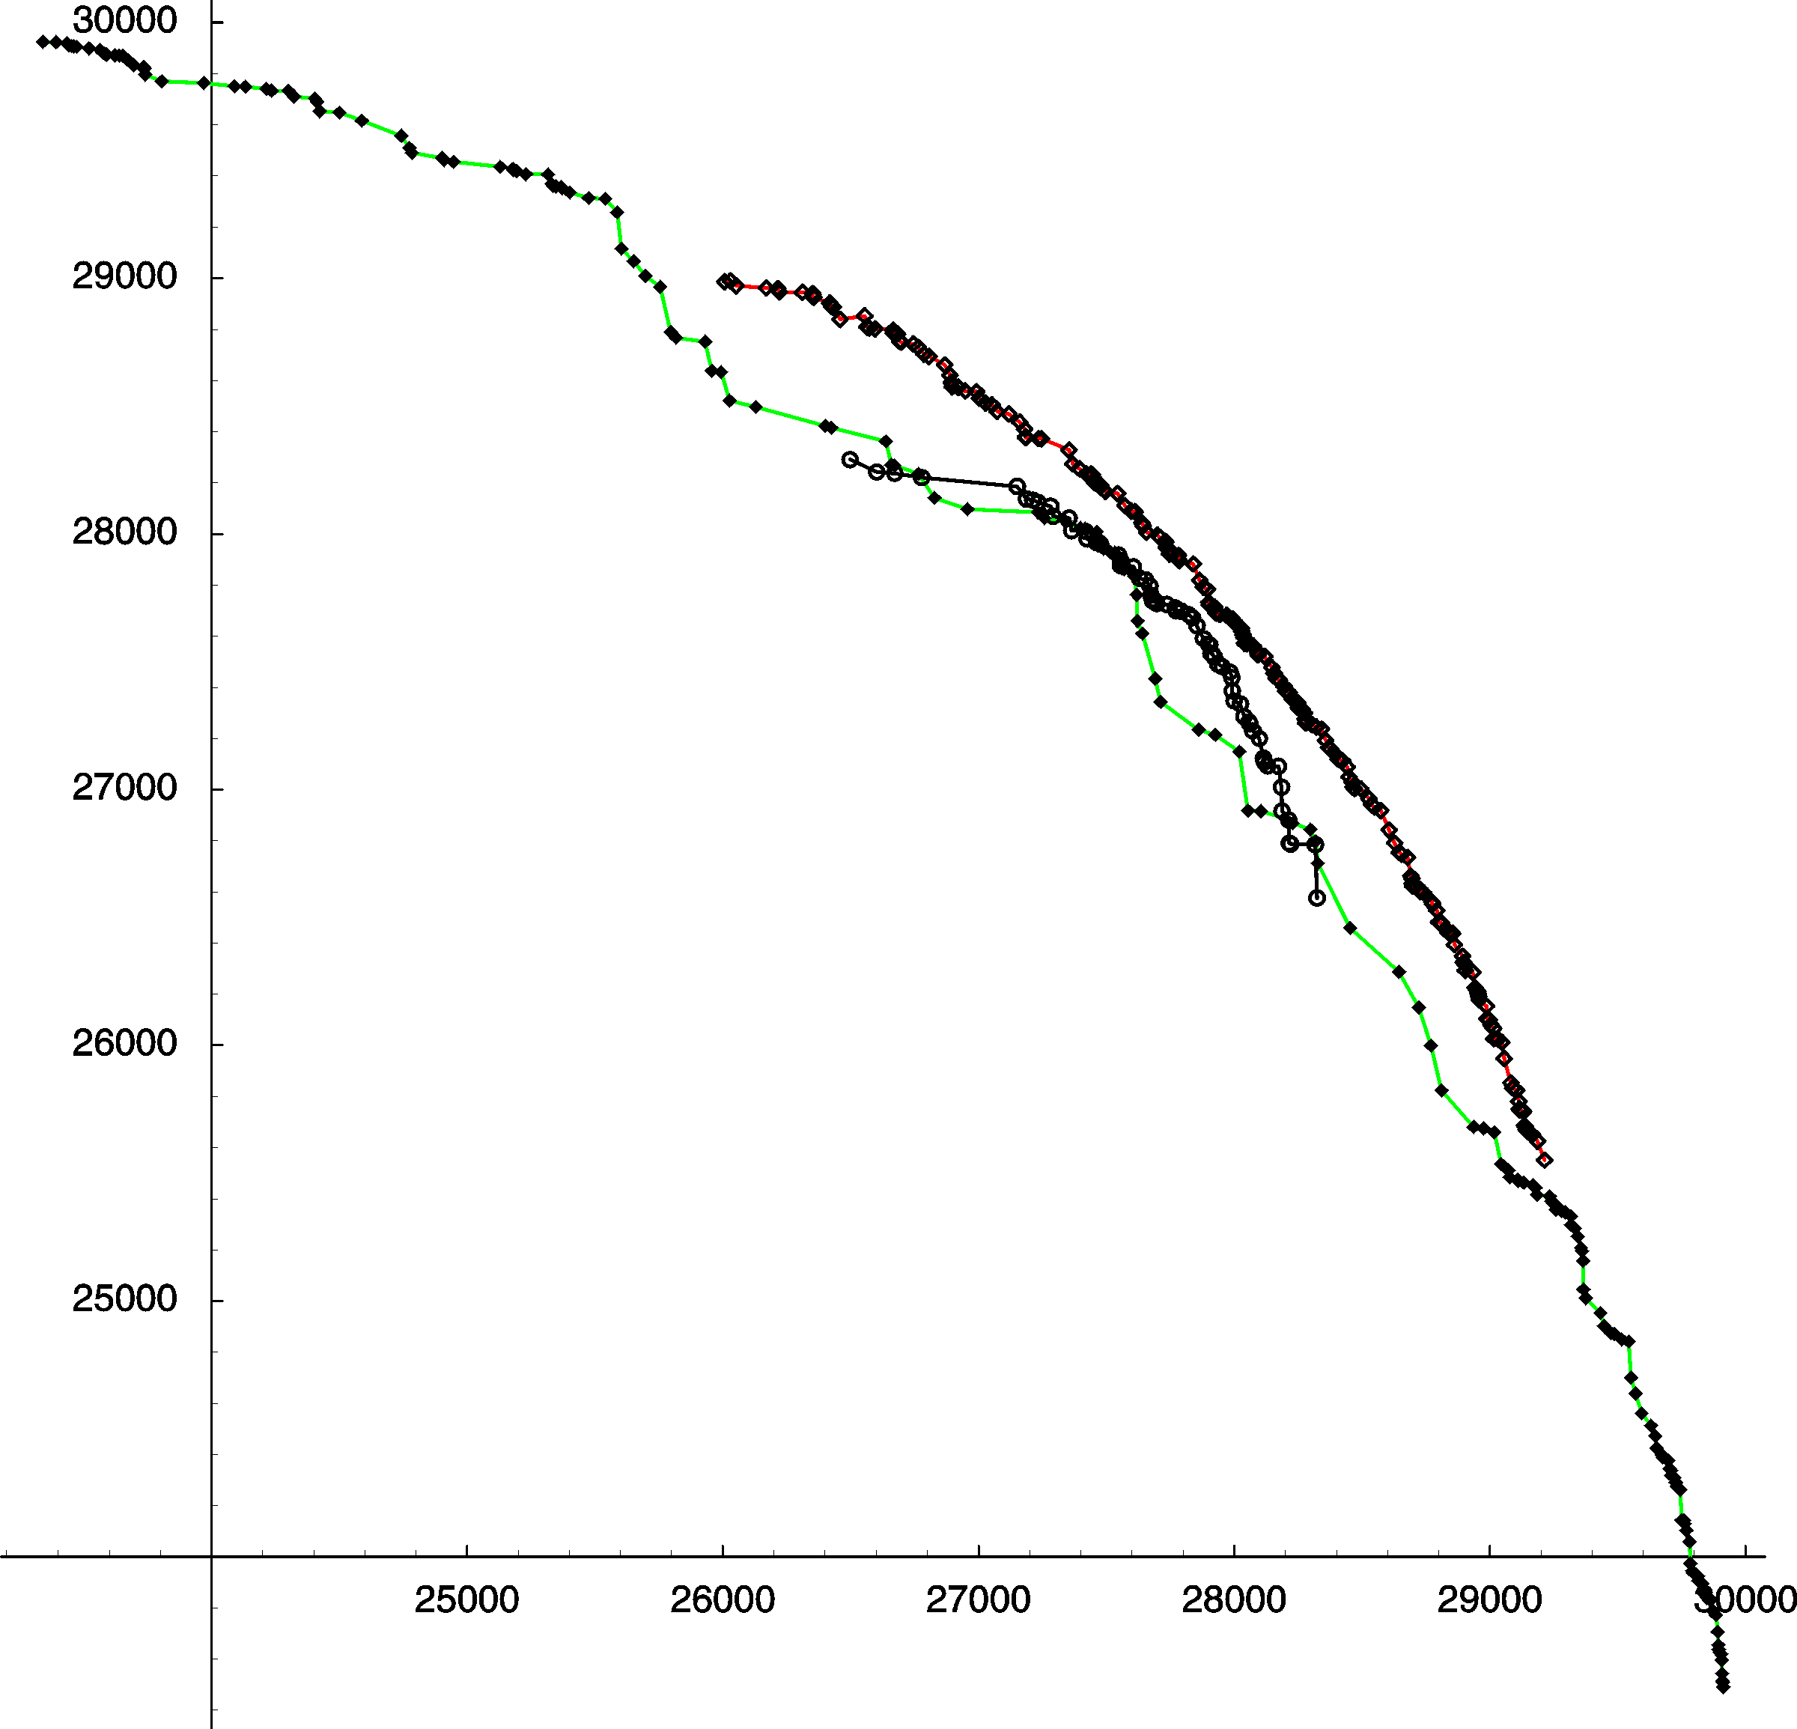
Comparison of Three Implementations
2-objective knapsack problem
SPEA2
VEGA
extended VEGA
Trade-off between
distance and diversity?

Slide 8

Performance Assessment: Approaches
❶ Theoretically (by analysis): difficult
  Limit behavior (unlimited run-time resources)
  Running time analysis
❷ Empirically (by simulation): standard
Problems: randomness, multiple objectives
Issues: quality measures, statistical testing,
benchmark problems, visualization, …
Which technique is suited for which problem class?

Slide 9
The Need for Quality Measures
A
A
B
B
Is A better than B?
independent of
user preferences
Yes (strictly) No
dependent on
user preferences
How much? In what aspects?
Ideal: quality measures allow to make both type of statements

Slide 10
Overview
❶ introduction
❷ limit behavior
❸ run-time
❹ performance measures

Slide 11
Analysis: Main Aspects
Evolutionary algorithms are random search heuristics
Qualitative:
Limit behavior for t → ∞
Probability{Optimum found}
1
Algorithm A applied to Problem B
Quantitative:
Expected Running Time E(T)
1/2
∞
Computation Time
(number of iterations)
Notes:
This diagram shows the probability distribution that a random search algorithm has found the optimum for a given number of iterations.
The limit behavior mean that we..., it is a qualitative view: the algorithm converges to the optimum with probability one or not.
To make more precise quantitative statements, we have to analyse the RUNNING TIME, i.e., to analyse the probability distribution in detail.

Slide 12
Archiving
optimization
archiving
generate
update, truncate
finite
memory
every solution
at least once
finite
archive A
f2
Requirements:
Convergence to Pareto front
Bounded size of archive
Diversity among the stored solutions
f1

Slide 13
Problem: Deterioration
New solution accepted in t+1 is dominated by a solution found previously (and “lost” during the selection process)
f2
t
f2
t+1
bounded archive (size 3)
discarded
new solution
new solution
f1
f1

Slide 14
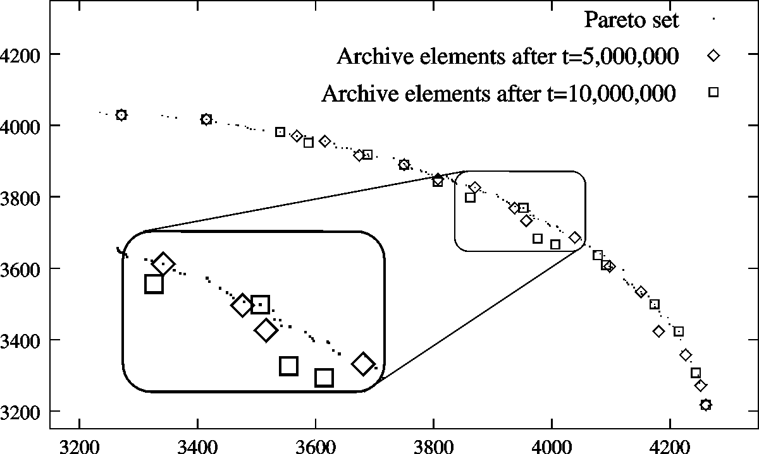
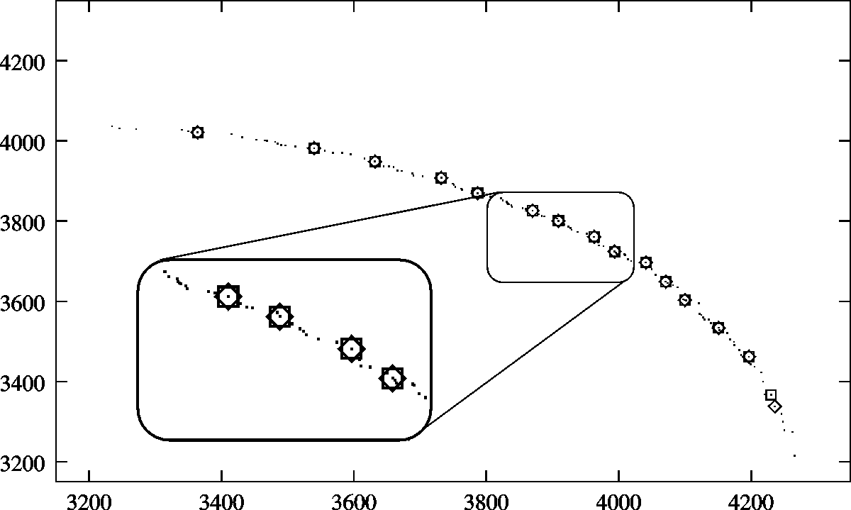
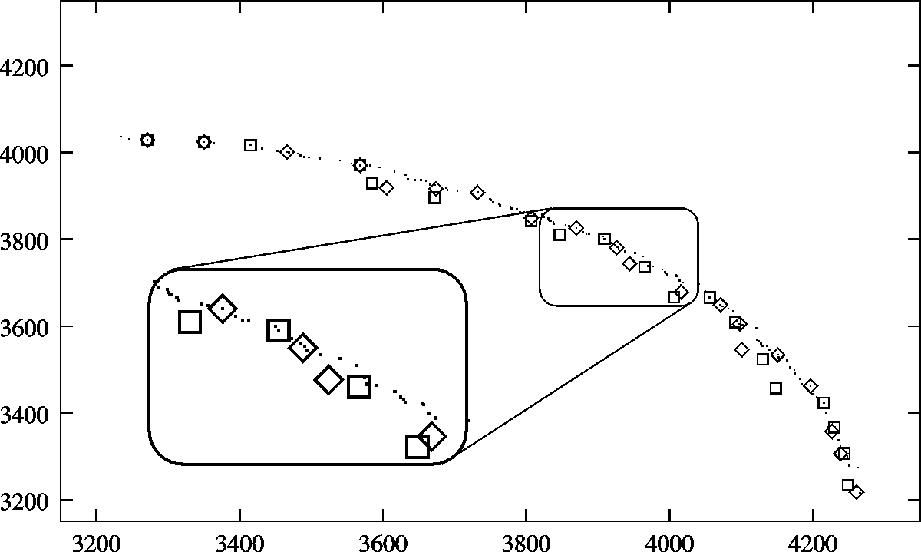
Problem: Deterioration
Goal: Maintain “good” front
(distance + diversity)
But: Most archiving
strategies may forget
Pareto-optimal solutions…
NSGA-II
SPEA

Slide 15
Limit Behavior: Related Work
Requirements for archive:
Convergence
Diversity
Bounded Size
[Rudolph 98,00] [Veldhuizen 99]
[Rudolph 98,00] [Hanne 99]
in this work
“store all”
“store one”
(impractical)
(not nice)
convergence to whole Pareto front (diversity trivial)
convergence to Pareto front subset (no diversity control)
Notes:
Surprizingly(!), no algorithm fulfills all these requirements so far!
... and we have shown how this can be done

Slide 16
Solution Concept: Epsilon Dominance
ε-dominated
dominated
Definition 1: ε-Dominance
A ε-dominates B iff
(1+ε)·f(A) ≥ f(B)
Definition 2: ε-Pareto set
A subset of the Pareto-optimal
set which ε-dominates all Pareto-
optimal solutions
(known since 1987)
Pareto set
ε-Pareto set

Slide 17
Keeping Convergence and Diversity
Goal: Maintain ε-Pareto set
Idea: ε-grid, i.e. maintain a
set of non-dominated
boxes (one solution
per box)
Algorithm: (ε-update)
Accept a new solution f if
❶ the corresponding box is not dominated by any box represented in the archive A
AND
❷ any other archive member in the same box is dominated by the new solution
y2
3
(1+ε)
2
(1+ε)
(1+ε)
1
y1
(1+ε)
2
3
1
(1+ε)
(1+ε)

Slide 18
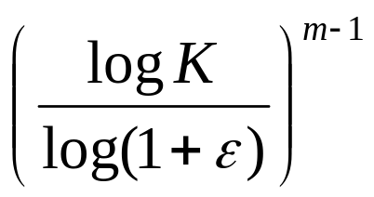
Correctness of Archiving Method
Theorem:
Let F = (f1, f2, f3, …) be an infinite sequence of objective vectors
one by one passed to the ε-update algorithm, and F_{t} the union of
the first t objective vectors of F.
Then for any t > 0, the following holds:
❶ the archive A at time t contains an ε-Pareto front of F_{t}
❷ the size of the archive A at time t is bounded by the term
(K = “maximum objective value”, m = “number of objectives”)
Notes:
We can prove correctness... and size bound according to this term

Slide 19
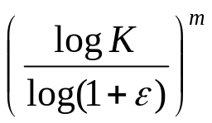
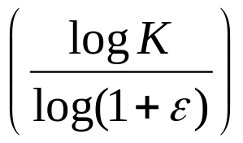

Correctness of Archiving Method
Sketch of Proof:
❶ 3 possible failures for A_{t} not being an ε-Pareto set of F_{t} (indirect proof)
at time k ≤ t a necessary solution was missed
at time k ≤ t a necessary solution was expelled
A_{t} contains an f ∉ Pareto set of F_{t}
❷
Number of total boxes in objective space:
Maximal one solution per box accepted
Partition into chains of boxes

Slide 20
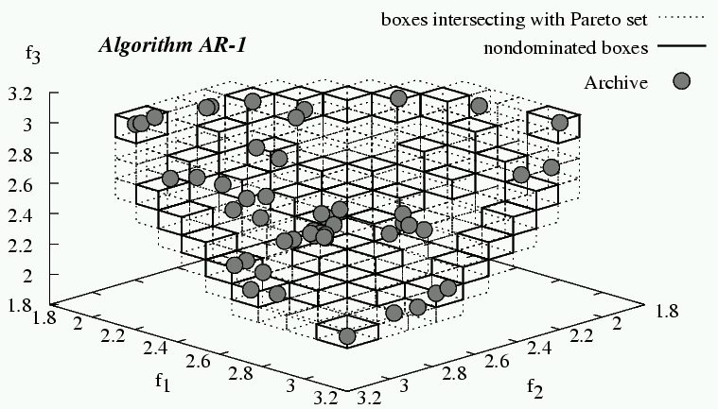
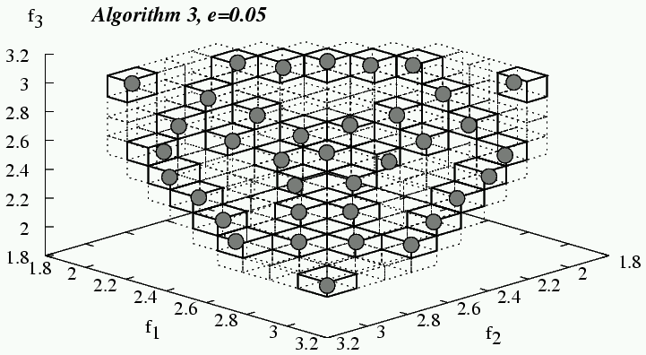
Simulation Example
Rudolph and Agapie, 2000
Epsilon- Archive

Slide 21
Overview
❶ introduction
❷ limit behavior
❸ run-time
❹ performance measures

Slide 22
Running Time Analysis: Related Work
problem domain
type of results
expected RT (bounds)
RT with high probability (bounds)
[Mühlenbein 92]
[Rudolph 97]
[Droste, Jansen, Wegener 98,02]
[Garnier, Kallel, Schoenauer 99,00]
[He, Yao 01,02]
discrete search spaces
Single-objective EAs
continuous search spaces
asymptotic convergence rates
exact convergence rates
[Beyer 95,96,…]
[Rudolph 97]
[Jagerskupper 03]
[none]
Multiobjective EAs
Notes:
Though much work has been done in the single-objective case, no results were available for the multiobjective case.

Slide 23
Methodology
Typical “ingredients”
of a Running Time Analysis:
Simple algorithms
Simple problems
Analytical methods & tools
Here:
SEMO, FEMO, GEMO (“simple”, “fair”, “greedy”)
mLOTZ, mCOCZ (m-objective Pseudo-Boolean problems)
General upper bound technique & Graph search process
Rigorous results for specific algorithm(s) on specific problem(s)
General tools & techniques
General insights (e.g., is a population beneficial at all?)

Slide 24
Three Simple Multiobjective EAs
insert
into population
if not dominated
flip
randomly
chosen bit
remove
dominated
from population
select
individual
from population
Variant 1: SEMO
Each individual in the
population is selected
with the same probability
(uniform selection)
Variant 2: FEMO
Select individual with
minimum number of
mutation trials
(fair selection)
Variant 3: GEMO
Priority of convergence
if there is progress
(greedy selection)

Slide 25
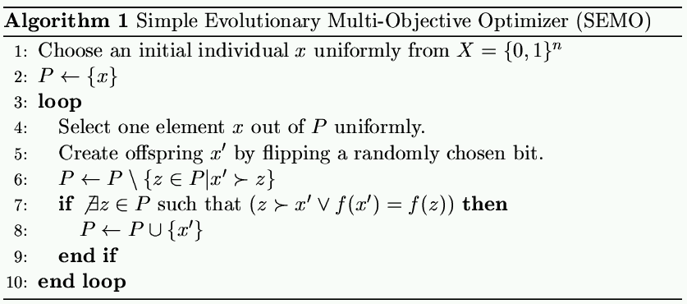
SEMO
x
uniform selection
single point
mutation
include,
if not dominated
population P
x’
remove dominated and duplicated

Slide 26
Example Algorithm: SEMO
Simple Evolutionary Multiobjective Optimizer
Start with a random solution
Choose parent randomly (uniform)
Produce child by variating parent
If child is not dominated then
  add to population
  discard all dominated
Goto 2

Slide 27
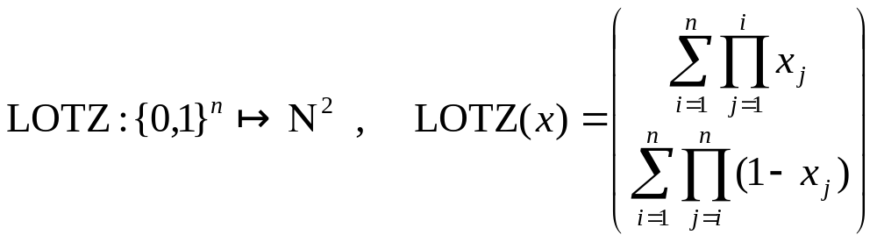
Example Problem: LOTZ (Leading Ones, Trailing Zeroes)
Given:
  Bitstring
Objective:
  Maximize # of “leading ones”
  Maximize # of “trailing zeroes”
1
1
1
1
1
1
0
1
1
0
0
0
0

Slide 28
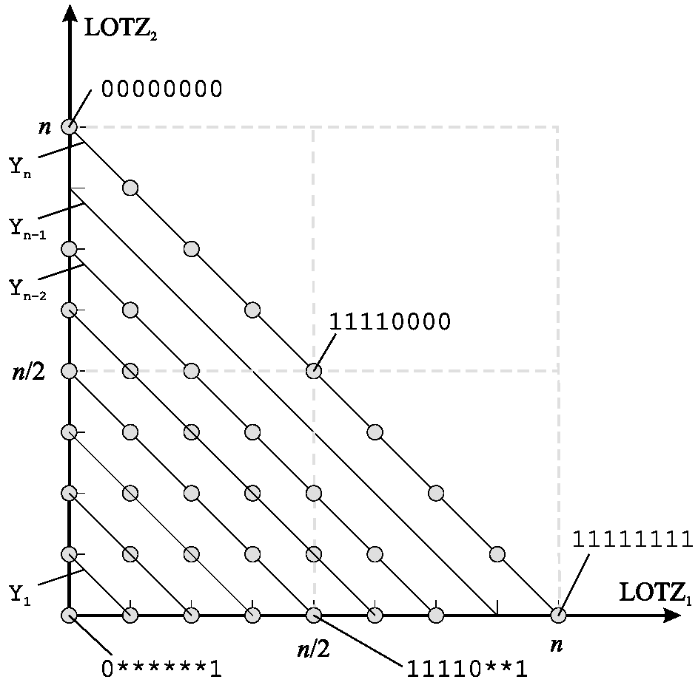
Run-Time Analysis: Scenario
Problem:
leading ones, trailing zeros (LOTZ)
Variation:
single point mutation
one bit per individual
1
1
0
1
0
0
0
1
1
0
1
0
0
0
1
1
1
1
0
0
0

Slide 29
The Good News
SEMO behaves like a single-objective EA until the Pareto set
has been reached...
trailing 0s
y2
Phase 1:
only one
solution stored
in the archive
Phase 2:
only Pareto-optimal
solutions stored
in the archive
y1
leading 1s

Slide 30
SEMO: Sketch of the Analysis I
Phase 1: until first Pareto-optimal solution has been found
i → i-1: probability of a successful mutation ≥ 1/n
expected number of mutations = n
i=n → i=0: at maximum n-1 steps (i=1 not possible)
expected overall number of mutations = O(n²)
leading 1s trailing 0s
1
1
0
1
1
0
0
i = number of ‘incorrect’ bits

Slide 31
SEMO: Sketch of the Analysis II
Phase 2: from the first to all Pareto-optimal solutions
j → j+1: probability of choosing an outer solution ≥ 1/j, ≤ 2/j
probability of a successful mutation ≥ 1/n , ≤ 2/n
expected number T_{j} of trials (mutations) ≥ nj/4, ≤ nj
j=1 → j=n: at maximum n steps ⇒ n³/8 + n²/8 ≤ ∑ T_{j} ≤ n³/2 + n²/2
expected overall number of mutations = Θ(n³)
j = number of optimal solutions in the
population
Pareto set

Slide 32
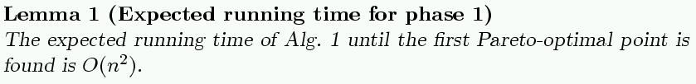
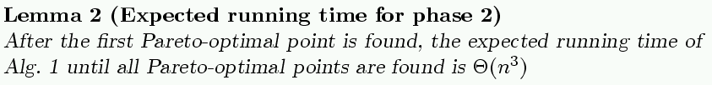
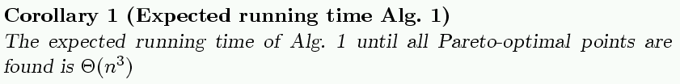
SEMO on LOTZ

Slide 33
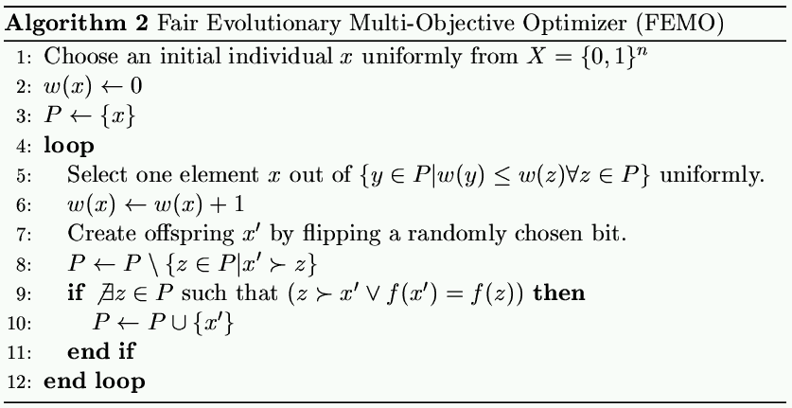
Can we do even better ?
Our problem is the exploration of the Pareto-front.
Uniform sampling is unfair as it samples early found Pareto-points more frequently.

Slide 34
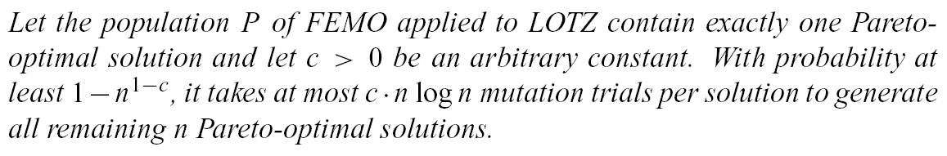

FEMO on LOTZ
Sketch of Proof
111111
111100
110000
000000
111110
111000
100000
Probability for each individual, that parent did not generate it with c/p log n trials:
n individuals must be produced. The probability that one needs more
than c/p log n trials is bounded by n^{1-c}.

Slide 35
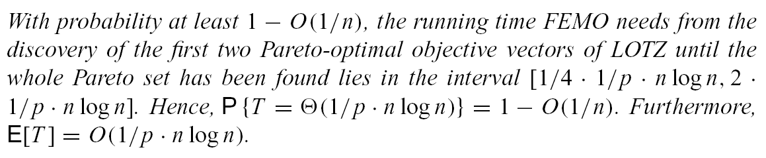
FEMO on LOTZ
Single objective (1+1) EA with multistart strategy (epsilon-constraint method) has running time Θ(n³).
EMO algorithm with fair sampling has running time
Θ(n² log(n)).

Slide 36
Generalization: Randomized Graph Search
Pareto front can be modeled as a graph
Edges correspond to mutations
Edge weights are mutation probabilities
How long does it take to explore the whole graph?
How should we select the “parents”?

Slide 37
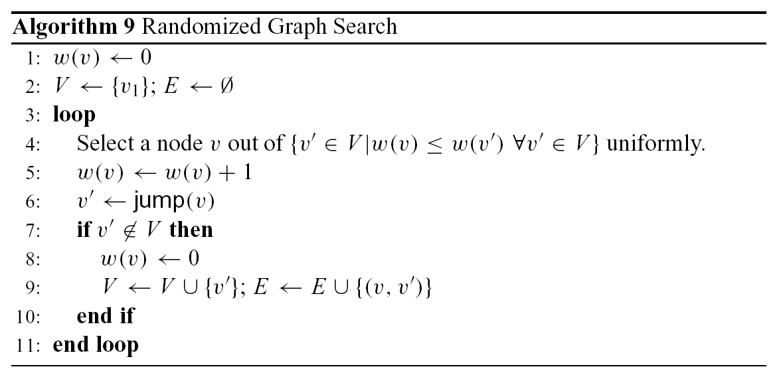
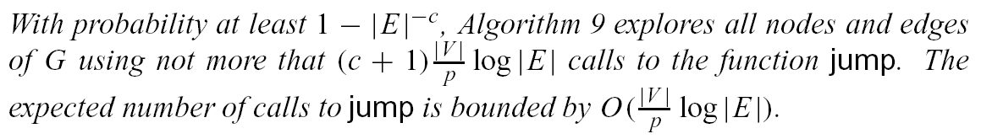
Randomized Graph Search

Slide 38
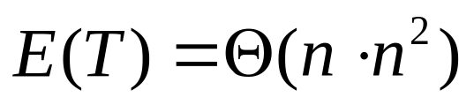
Comparison to Multistart of Single-objective Method
Underlying concept:
Convert all objectives except of one into constraints
Adaptively vary constraints
f2
maximize f₁
s.t. f_{i} > c_{i}, i ∈ {2,…,m}
Find one point
feasible region
constraint
feasible region
constraint
number of points
feasible region
constraint
f1

Slide 39
Greedy Evolutionary Multiobjective Optimizer (GEMO)
Idea:
Mutation counter for each individual
Start with a random solution
Choose parent with smallest counter; increase this counter
Mutate parent
If child is not dominated then
  If child not equal to anybody
    add to population
  else if child equal to somebody
    if counter = ∞: set back to 0
  if child dominates anybody
    set all other counters to ∞
  discard all dominated
Goto 2
II. Broaden search effort
I. Focus search effort
… without knowing where we are!

Slide 40
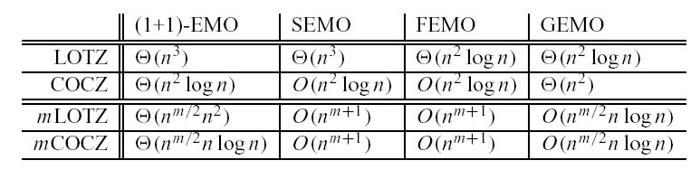
Running Time Analysis: Comparison
Algorithms
Problems
Population-based approach can be more efficient than multistart of single membered strategy

Slide 41
Overview
❶ introduction
❷ limit behavior
❸ run-time
❹ performance measures

Slide 42
Performance Assessment: Approaches
❶ Theoretically (by analysis): difficult
  Limit behavior (unlimited run-time resources)
  Running time analysis
❷ Empirically (by simulation): standard
Problems: randomness, multiple objectives
Issues: quality measures, statistical testing,
benchmark problems, visualization, …
Which technique is suited for which problem class?

Slide 43
The Need for Quality Measures
A
A
B
B
Is A better than B?
independent of
user preferences
Yes (strictly) No
dependent on
user preferences
How much? In what aspects?
Ideal: quality measures allow to make both type of statements

Slide 44
Independent of User Preferences
Pareto set approximation (algorithm outcome) =
set of incomparable solutions
Ω = set of all Pareto set approximations
weakly dominates
= not worse in all objectives
sets not equal
dominates
= better in at least one objective
strictly dominates
= better in all objectives
is incomparable to
= neither set weakly better
A
B
C
D
B
A
A
C
D
C
B
C

Slide 45
Dependent on User Preferences
Goal: Quality measures compare two Pareto set approximations A and B.
application of
quality measures
(here: unary)
A B
hypervolume
432.34 420.13
distance
0.3308 0.4532
A
diversity
0.3637 0.3463
spread
0.3622 0.3601
B
cardinality
6 5
comparison and
interpretation of
quality values
“A better”

Slide 46
Quality Measures: Examples
Unary
Hypervolume measure
Binary
Coverage measure
performance
performance
S(A) = 60%
B
C(A,B) = 25%
C(B,A) = 75%
A
S(A)
A
cheapness
cheapness
[Zitzler, Thiele: 1999]

Slide 47
Previous Work on Multiobjective Quality Measures
Status:
Visual comparisons common until recently
Numerous quality measures have been proposed
since the mid-1990s
[Schott: 1995][Zitzler, Thiele: 1998][Hansen, Jaszkiewicz: 1998][Zitzler: 1999]
[Van Veldhuizen, Lamont: 2000][Knowles, Corne , Oates: 2000][Deb et al.: 2000] [Sayin: 2000][Tan, Lee, Khor: 2001][Wu, Azarm: 2001]…
Most popular: unary quality measures (diversity + distance)
No common agreement which measures should be used
Open questions:
What kind of statements do quality measures allow?
Can quality measures detect whether or that a Pareto set approximation is better than another?
[Zitzler, Thiele, Laumanns, Fonseca, Grunert da Fonseca: 2003]

Slide 48
Notations
Def: quality indicator
I: Ω^{m} → ℜ
Def: interpretation function
E: ℜ^{k} × ℜ^{k} → {false, true}
Def: comparison method based on I = (I₁, I₂, …, I_{k}) and E
C: Ω × Ω → {false, true}
where
A, B ℜ^{k} × ℜ^{k} {false, true}
quality
indicators
interpretation
function

Slide 49
Comparison Methods and Dominance Relations
Compatibility of a comparison method C:
C yields true ⇒ A is (weakly, strictly) better than B
(C detects that A is (weakly, strictly) better than B)
Completeness of a comparison method C:
A is (weakly, strictly) better than B ⇒ C yields true
Ideal: compatibility and completeness, i.e.,
A is (weakly, strictly) better than B ⇔ C yields true
(C detects whether A is (weakly, strictly) better than B)

Slide 50
Limitations of Unary Quality Measures
Theorem:
There exists no unary quality measure that is able to detect
whether A is better than B.
This statement even holds, if we consider a finite combination
of unary quality measures.
There exists no combination of unary measures
applicable to any problem.

Slide 51
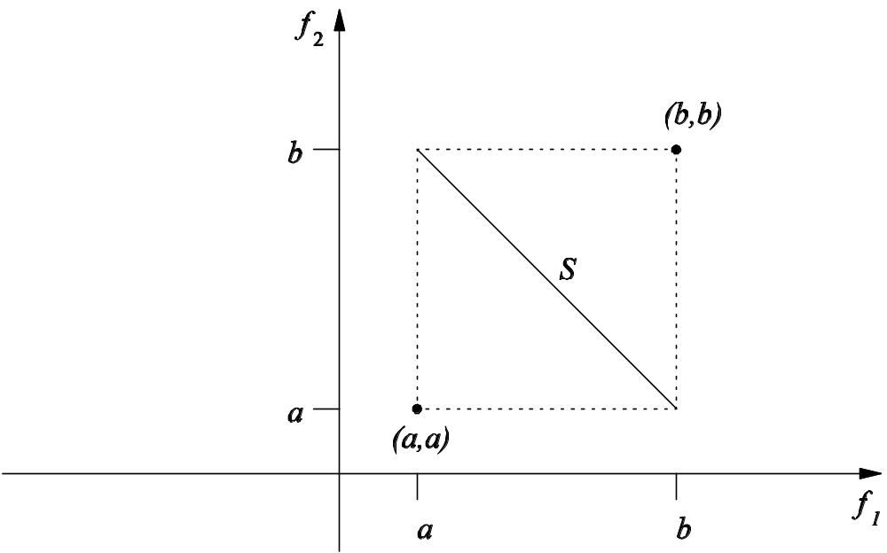

Theorem 2: Sketch of Proof
Any subset A ⊆ S is a Pareto set approximation
Lemma: any A’, A’’ ⊆ S must be mapped to a different point in ℜ^{k}
Mapping from 2^{S} to ℜ^{k} must be
an injection, but
Cardinality of 2^{S} greater than ℜ^{k}

Slide 52
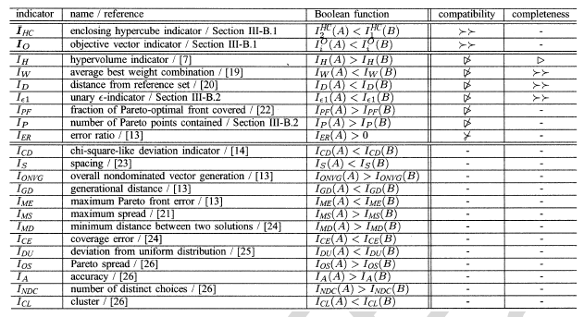
Power of Unary Quality Indicators
strictly dominates doesn’t weakly dominate doesn’t dominate weakly dominates

Slide 53
Quality Measures: Results
Basic question: Can we say on the basis of the quality measures
whether or that an algorithm outperforms another?
application of
quality measures
S T
hypervolume
432.34 420.13
distance
0.3308 0.4532
S
diversity
0.3637 0.3463
T
spread
0.3622 0.3601
cardinality
6 5
There is no combination of unary quality measures such that
S is better than T in all measures is equivalent to S dominates T
Unary quality measures usually do not tell that
S dominates T; at maximum that S does not dominate T
[Zitzler et al.: 2002]

Slide 54
A New Measure: ε-Quality Measure
Two solutions:
E(a,b) =
max_{1≤ i ≤ n} min_{ε} ε ⋅ f_{i}(a) ≥ f_{i}(b)
Two approximations:
E(A,B) =
max_{b ∈ B} min_{a ∈ A} E(a,b)
E(a,b) = 2
E(b,a) = ½
E(A,B) = 2
E(B,A) = ½
2
b
2
B
1
1
a
A
1
2
1
2
4
Advantages: allows all kinds of statements (complete and compatible)

Slide 55
Selected Contributions
Algorithms:
Improved techniques [Zitzler, Thiele: IEEE TEC1999]
[Zitzler, Teich, Bhattacharyya: CEC2000] [Zitzler, Laumanns, Thiele: EUROGEN2001]
Unified model [Laumanns, Zitzler, Thiele: CEC2000]
[Laumanns, Zitzler, Thiele: EMO2001]
Test problems [Zitzler, Thiele: PPSN 1998, IEEE TEC 1999]
[Deb, Thiele, Laumanns, Zitzler: GECCO2002]
Theory:
Convergence/diversity [Laumanns, Thiele, Deb, Zitzler: GECCO2002]
[Laumanns, Thiele, Zitzler, Welzl, Deb: PPSN-VII]
Performance measure [Zitzler, Thiele: IEEE TEC1999]
[Zitzler, Deb, Thiele: EC Journal 2000]
[Zitzler et al.: GECCO2002]
  How to apply (evolutionary) optimization algorithms to
  large-scale multiobjective optimization problems?

